Slide 1

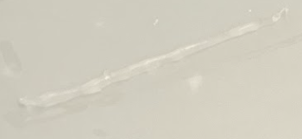
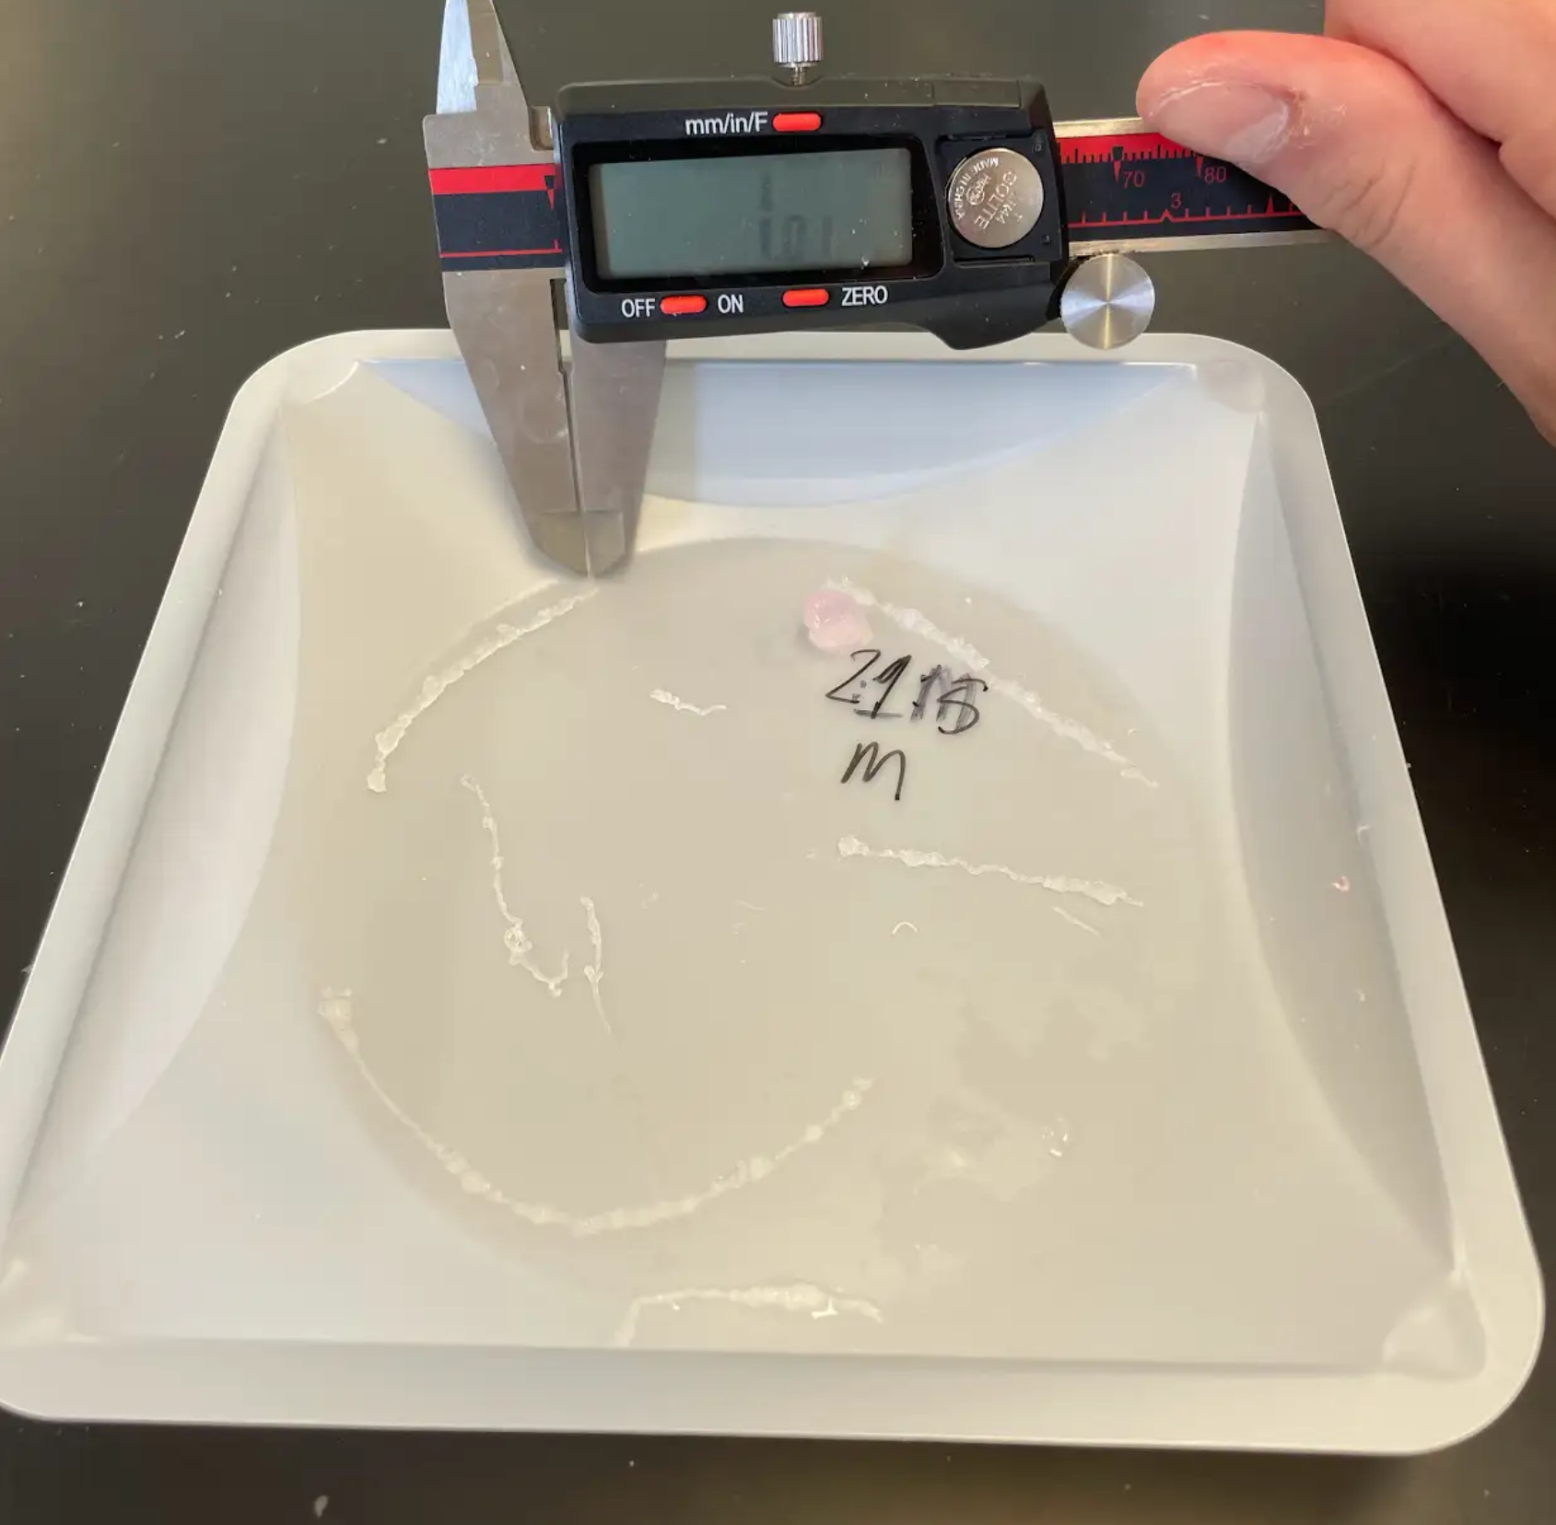
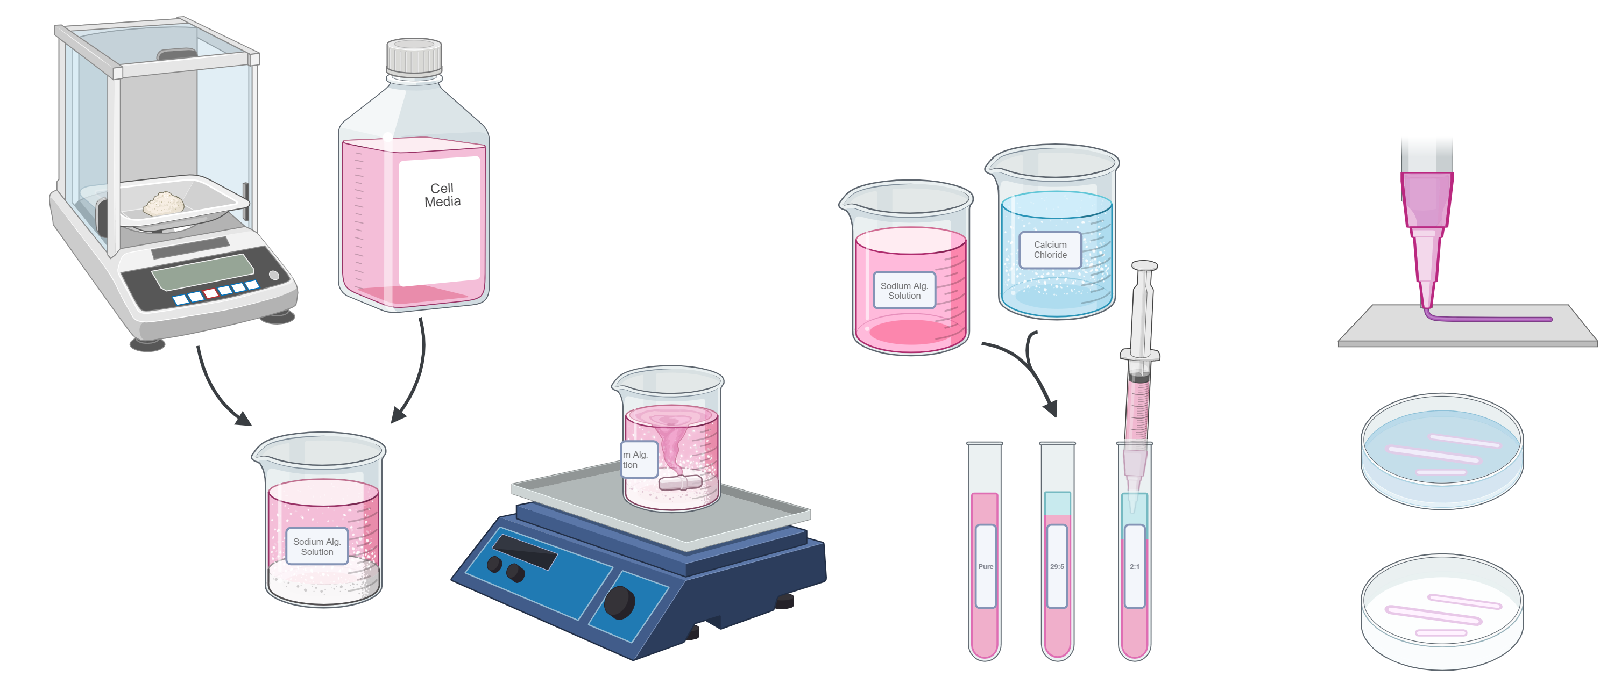
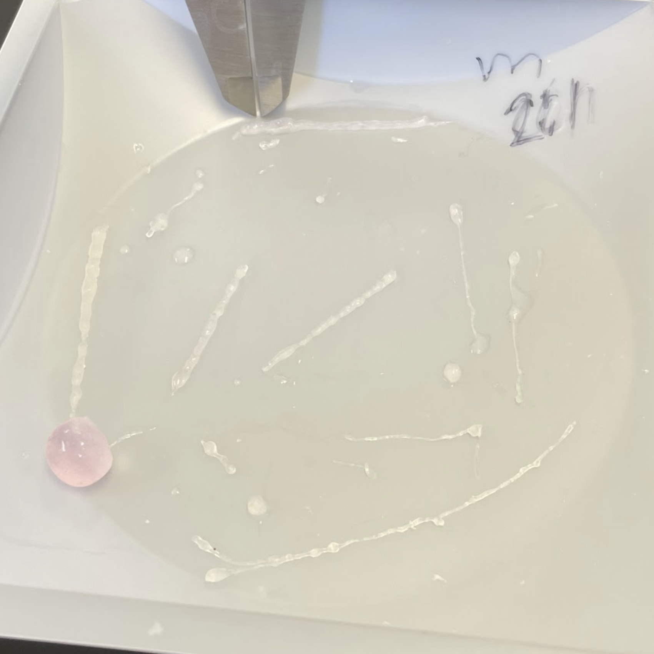
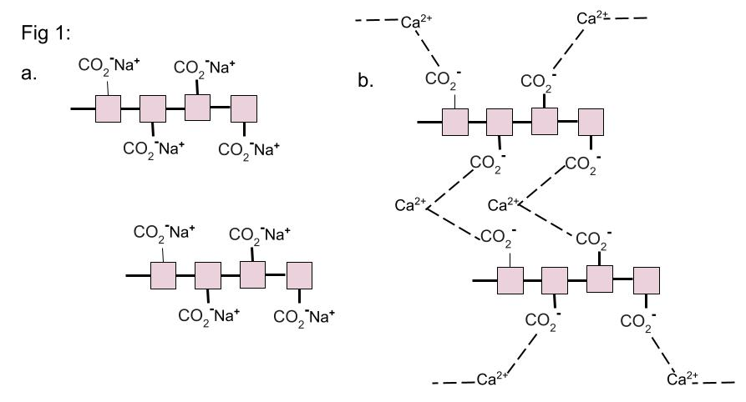
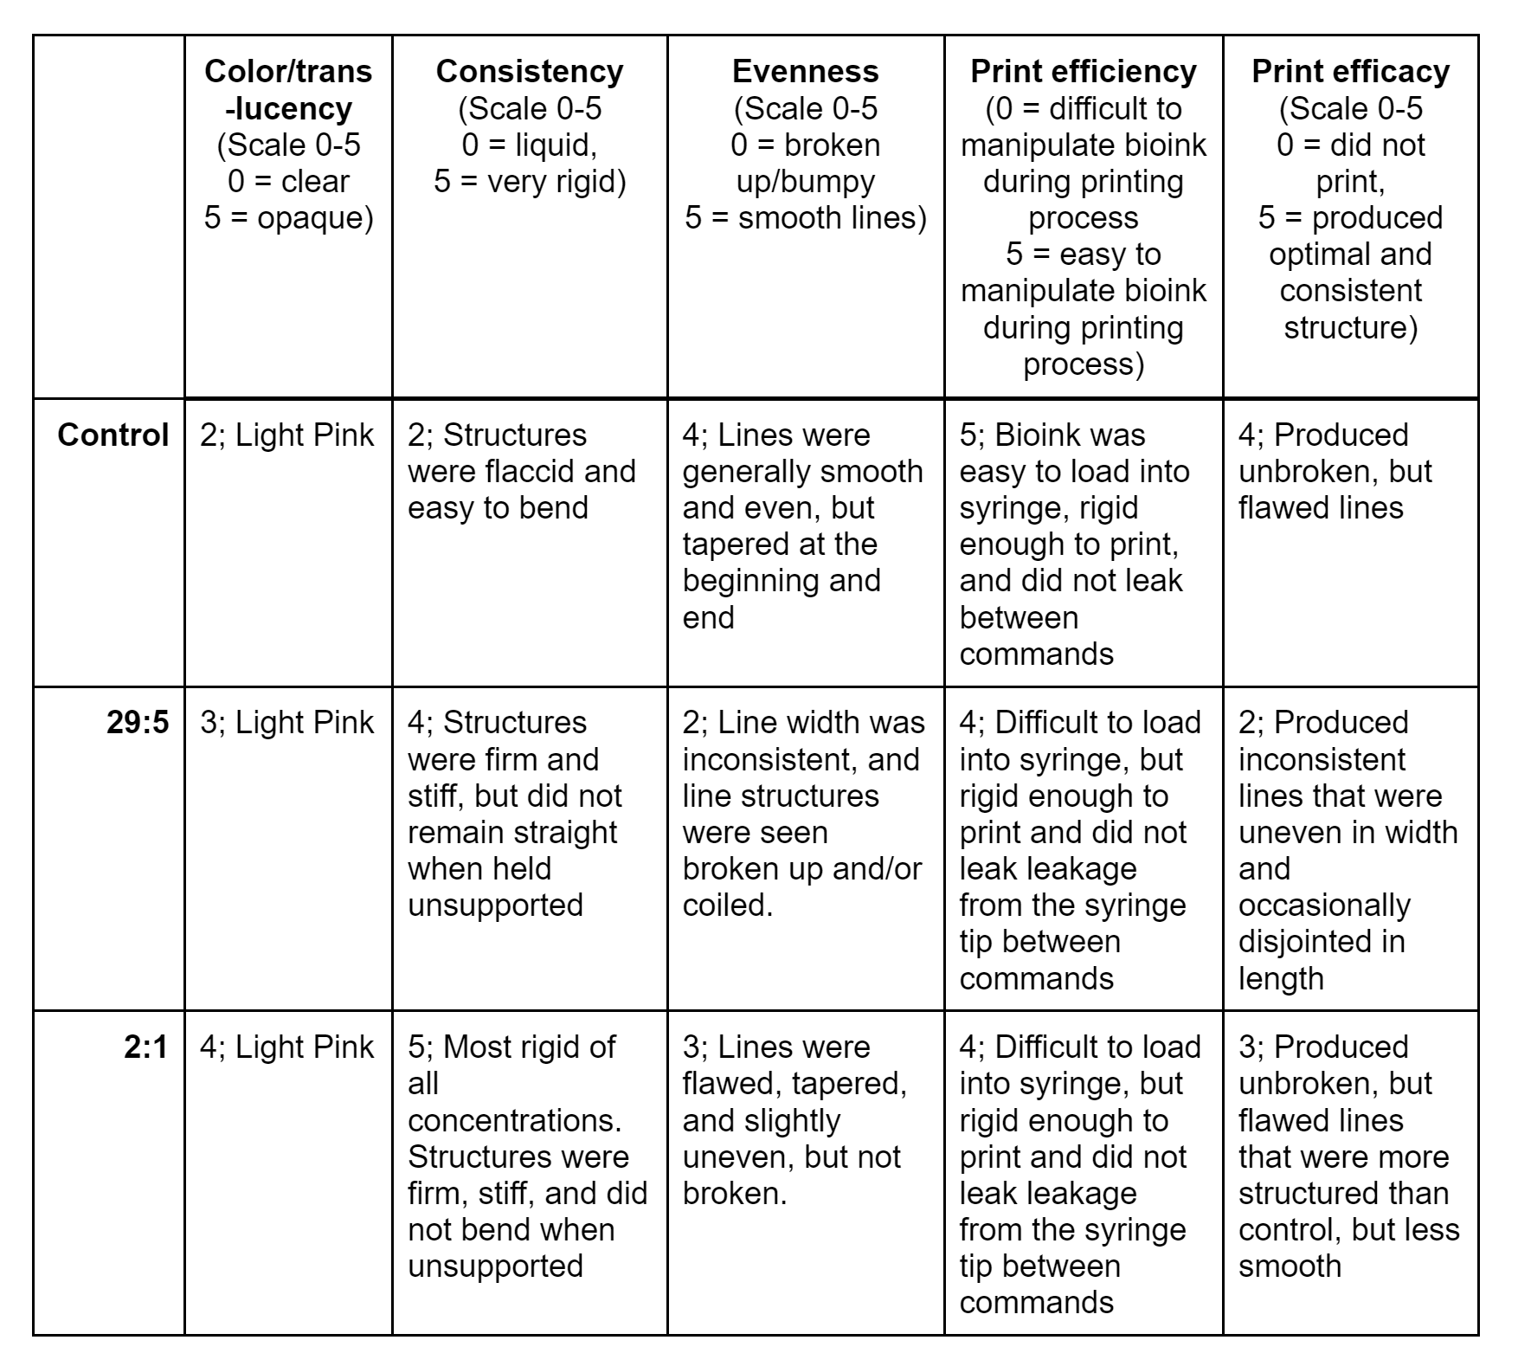

The Structural Results of Calcium Chloride Ratios Used in Pre-Crosslinked Sodium Alginate Bioinks
Beatrice Zaleski, Anya Bobkoskie
Department of Electrical and Biomedical Engineering
Purpose
Methods
a.
b.
3D Bioprinting is a cutting-edge method being applied to the field of biomedical engineering with the goal of creating customizable, easily produced biostructures, intended to resolve medical issues intended to resolve medical issues such as tissue defects⁴, organ failure², and chronic wounds¹.However, due to the field’s novelty, there remains work to be done in refining the tools and techniques currently being used, in order to ensure products are predictable, easily replicated, stable, and functional, as well as ensuring precision and accuracy during the printing process itself⁶. From this, we aim to optimize the 3D bioinks being used to create these structures, focusing specifically on the potential for applying sodium alginate (Na-Alg) as a bioink medium³, looking at the results of its use in combination with various concentrations of calcium chloride (CaCl₂).
a.
Fig 2:
Figure 2: visual representation of the applied experimental method, wherein (a) sodium alginate powder was weighed and combined in a solution of cell media; (b) was left to combine on a magnetic stir plate; before being (c) transferred to vials containing varying levels of calcium chloride, pipetted repeatedly to combine; and finally were extracted from their vials, (d) loaded into the bioprinter, printed; and left to crosslink in calcium chloride solution, before later removal, facilitating their structural analysis.
c.
d.
c.
d.
e.
b.
Lines printed with Na-Alg:CaCl₂ ratios of (a) 1:0, (b,c) 29:5, and (d,e) 2:1
Hypothesis
Results
Discussion and Conclusion
A hydrophilic polysaccharide, Na-Alg is characterized by its biocompatible and biodegradable properties, making it a natural subject of interest when exploring potential biomedical applications. Na-Alg is also distinct due to its unique chemical structure, with each of its monosaccharide subunits containing an attached carboxylate ion (CO₂Na⁺). This enables it the ability to form interpolymer crosslinks when combined with a solution of calcium ions, such as calcium chloride, as the Ca²⁺ binds two CO₂₋ions together from nearby polymers (Figure 1). Once crosslinked, Na-Alg will solidify from its typical gelatinous structure to a more solid form.
In this experiment, we will be examining the potential ways in which this property can be manipulated when using Na-Alg as a medium for bioprinting. Specifically, we will focus on the properties of a cell media-based sodium alginate solution when pre-crosslinked at a ratio of 29 parts Na-Alg solution to 5 parts calcium chloride (CaCl₂) solution, 2 parts Na-Alg to 1 part CaCl₂, and pure Na-Alg solution without the addition of CaCl₂.
To test the accuracy of these materials when applied as bioinks, we will be comparing the width (diameter) of the needle being used to print the ink (0.6096 mm) and the actual width of a printed line ($x)$through the formula:
$$\frac{|x−0.6096|}{0.6096}∗100$$
We hypothesize that the higher the ratio of CaCl₂ to Na-Alg, the more accurate the resultant print will be, with less error being calculated between the biostructure’s width and the print needle’s diameter. It is expected that, with more calcium ions present to join the Na-Alg strands, greater volumes of calcium chloride will result in denser networks of polymer crosslinks in the matrix of the sodium alginate gel. This is theorized to increase the rigidity and structural integrity of the bioink, resulting in reduced distortion and deformation during the printing process, and leading to more consistent and predictable dimensions throughout the printed structures.
The level of accuracy to which one can 3D print a device is of the utmost importance in ensuring its proper functionality and efficacy. Since structures built by the biomaterials being tested are intended for use within the human body and in treating various maladies, it is of the utmost importance that the best material for any given product is being applied. Additionally, many 3D printed biostructures are used in combination with live cell lines and cultures, and, therefore, determining how cell media-based sodium alginate solutions behave will allow for these structures to be optimally crafted.
In our experiment, we were able to determine the level of accuracy, precision, and consistency observed for varying ratios of Na-Alg:CaCl₂, by measuring the percent error in width when compared to the initial needle tip diameter (Figure 3); the standard deviation of line widths measured (Figure 4); and the average difference in width throughout a single line (Figure 5), respectively.
It can be observed from these datapoints that utilizing a 2:1 Na-Alg to calcium chloride ratio resulted in the most accurate structures (Figure 3), as well as displayed great consistency than a 29:5 ratio (Figure 5). Additionally, the average width of the 2:1 ratio lines displayed comparable levels of precision to that of the control, with both preforming better than the 29:5 ratio (Figure 4a).
While the control bioink, which was not pre-crosslinked with calcium chloride, displayed more precise average (Figure 4a) and maximum widths (Figure 4c), and a significantly greater level of consistency between its maximum and minimum widths (Figure 5a), it lacked the rigidity, stability (Table 1), and accuracy (Figure 3) seen in the experimental groups.
From this, we can conclude that 2 parts sodium alginate for every 1 part calcium chloride is likely the ideal ratio for use in 3D printing biostructures. Coupled with its stable and rigid structure (Table 1), its high levels of accuracy (Figure 3), precision (Figure 4), and consistency (Figure 5) allow for optimal printing results.
c.
Figure 3:
visual representation of percent error between expected line width (0.6096 mm; corresponding to initial needle gauge) and resultant line width at (a) the average width, (b) minimum width, and (c) maximum width of any given line.
a.
b.
c.
a.
b.
Figure 5: visual representation of difference (mm) between the (a) maximum width of any given line and the minimum width of any given line; (b) the maximum width and average width of any given line; and (c) the average width and minimum width of any given line.
Table 1: a qualitative analysis of bioink print outcomes
Figure 4:
visual representation of standard deviation between the (a) average, (b) maximum, and (c) minimum widths recorded for each line.
c.
a.
b.
References
These results can be explained by the nature of crosslinking itself. As the calcium ions in CaCl₂ join the separate polymer strands found in sodium alginate gels, the material is able to solidify, resulting in an increased viscosity, rigidity, and firmness. However, these changes also make it slightly more difficult to print fluidly, as described by Poiseuille’s law, which relates flow rate to viscosity. To counteract this, the pressure applied by the bioprinter to the syringe of bioink must also be increased. That said, when printing our structures, we failed to account for this factor, and did not adjust the print parameters accordingly, likely resulting in the inconsistent line widths seen in the 29:5 and 2:1 ratios.
Additionally, the poor results displayed by the 29:5 ratio may be due to a failure in properly combining the solutions of sodium alginate and calcium chloride. Should this error have occurred, it would result in uneven linking of the Na-Alg polymer stands, and may explain the uneven, “lumpy” structures being produced (Table 1).
Should we repeat this experiment, first, we would correct for these errors by estimating the possible changes in the solutions’ viscosities and readjust the printer accordingly. While keeping this variable static allowed for a more direct comparison between the properties of each bioink, it inhibited us from observing the true potential of these materials and the extent to which they could be applied if used properly.
Similarly, we would make sure to thoroughly combine the two solutions when pre-crosslinking our sodium alginate bioinks, allowing for a better-quality outcome, more representative of the bioink’s full capabilities.
That said, the experiment was largely successful in determining the benefits and shortcomings of various ratios of sodium alginate to calcium chloride, allowing us to expand upon the scientific community's knowledge of the potential application of sodium alginate in 3D bioprinting settings, as well as the effects of pre-crosslinking with calcium chloride on overall structural outcome.
[1] Antezana P. E., Municoy S., Álvarez-Echazú M. I., Santo-Orihuela P. L., Catalano P. N., Al-Tel T. H., Kadumudi F. B., Dolatshahi-Pirouz A., Orive G., & Desimone M. F. (2022, February 21). The 3D bioprinted scaffolds for wound healing. Pharmaceutics. https://www.ncbi.nlm.nih.gov/pmc/articles/PMC8875365/
[2] Cui H., Nowicki M., Fisher J. P., & Zhang L. G. (2016, December 20). 3D bioprinting for organ regeneration. Advanced healthcare materials. https://www.ncbi.nlm.nih.gov/pmc/articles/PMC5313259/#:~:text=In%20this%20manner%2C%203D%20bioprinting,of%203D%20bioprinted%20organ%20analogues
[3] GhavamiNejad A., Ashammakhi N., Wu X. Y., & Khademhosseini A. (2020, September 16). Crosslinking strategies for 3D bioprinting of polymeric hydrogels. Small (Weinheim an der Bergstrasse, Germany). https://www.ncbi.nlm.nih.gov/pmc/articles/PMC7754762/
[4] Liu N., Zhang X., Guo Q., Wu T., & Wang Y. (2022, July 17). 3D bioprinted scaffolds for tissue repair and regeneration. Frontiers. https://www.frontiersin.org/articles/10.3389/fmats.2022.925321/full#:~:text=The%20emergence%20of%203D%20bioprinting,evaluated%20for%20a%20long%20time
[5] Sun L., Wang Y., Zhang S., Yang H., & Mao Y. (2023, June 5). 3D bioprinted liver tissue and disease models: Current advances and future perspectives. Biomaterials advances. https://pubmed.ncbi.nlm.nih.gov/37295133/
[6] Yang P., Ju Y., Hu Y., Xie X., Fang B., & Lei L. (2023, January 3). Emerging 3D bioprinting applications in plastic surgery. American Association for the Advancement of Science. https://www.ncbi.nlm.nih.gov/pmc/articles/PMC9808966/

